Slide 1
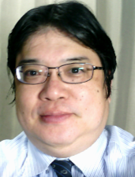

or-13. ゲーム理論，グラフ
（オペレーションズリサーチ）
URL: https://www.kkaneko.jp/cc/or/index.html
金子邦彦

Slide 2
13-1. ゲーム理論

Slide 3
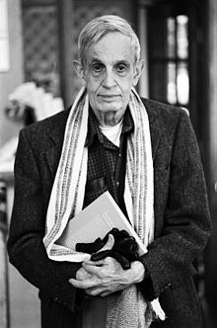
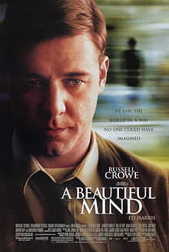
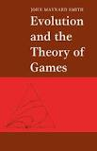
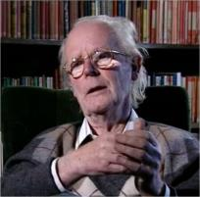
ゲーム理論
ゲーム理論は，各個人の利得を最大化しようと振舞うときの戦略について研究するもの
経済学や社会学の基礎をなすことも
John Maynard Smith により，生態系の理解にも役立つことが示唆されている
John Nash
John Maynard Smith

Slide 4
ゲーム理論の特徴
この授業では，次で説明している．
現実の世界を，「ゲーム」の世界に置き換える
各個人が，各個人の利得の最大化を目ざして行動する（非協力ゲーム）
前もって，利得が完全に分かるのが前提
全員が合理的に行動する（自分の利得の最大化のみを目指して行動する）
（ゲーム理論は，さらに大きな広がりがあるもの）

Slide 5
ゲーム理論のメリット
利得をもとに，行動の根拠を分析
一見，不思議な現象を，ゲーム理論による分析で分析できることも

Slide 6
ゲーム理論の例
動物が生き残るためには，どのような戦略をとるべきか
最適な戦略は，他の動物に応じて変えるべきか
  攻撃的であるべきか
  おとなしくあるべきか

Slide 7
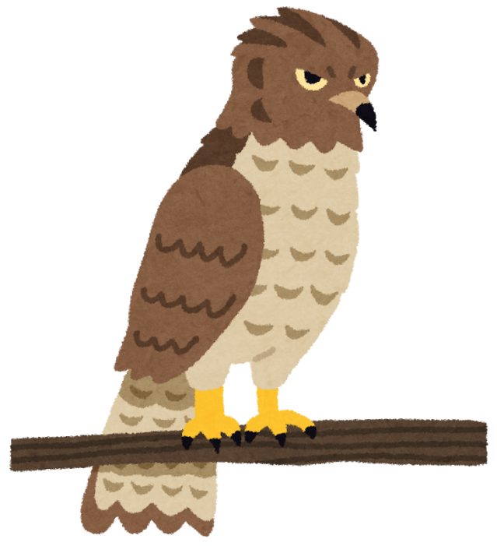
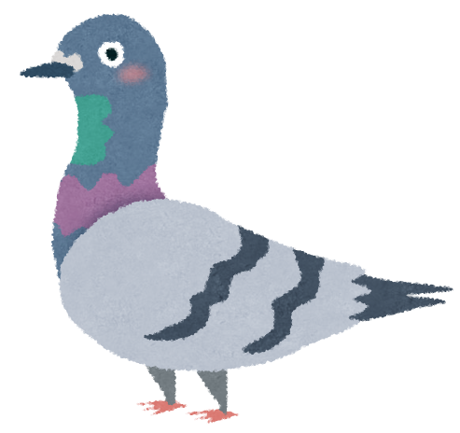
ものごとを，より深く理解するのに，ゲーム理論が助けになる場合も

Slide 8
複数の鷹と鳩が，たがいに関わりあいながら，生存をかける
  鷹（たか）
  鳩（はと）

Slide 9
鷹の戦略
資源（餌や水）を，他の生き物と争う
他の鷹には，必ず攻撃する
勝てば，餌や水などをすべて得る
負ければ，餌や水などを全く得られ無いうえに，けがをする
他の鷹への攻撃は，勝率は ５０％

Slide 10
鳩の戦略
資源（餌や水など）を争わない
鳩に対しては，攻撃しない
（餌や水などがあれば，半々に分ける）
鷹に対しても，攻撃しない
（餌や水などがあれば，すべて鷹に譲る）
鷹にあったら逃げるので（必ず逃げることができる）．ケガなどはない

Slide 11
鷹の戦略と，鳩の戦略のどちらが優れているか？
鷹と鳩の「どちらかが優れる」と思いますか？
鷹は勝ちますか？
鳩は耐えしのぐことができますか？

Slide 12
クイズ
鷹と鳩の「どちらかが優れる」と思いますか？
鷹
鳩
両方ともよい
両方ともよくない（他の優れたやり方がある）

Slide 13
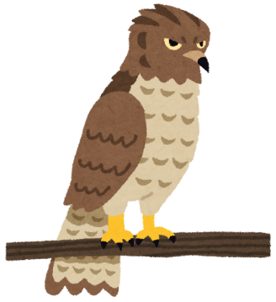
鷹の特性
仮に，鷹しかいない，とします．
鷹がたくさんいます．互いに攻撃しあいます
勝率は ５０％
Notes:
The first behaviour the students will explore is the Hawks. At this point you will need to explain the “rules.” Everyone in the class is going to be a Hawk. They are going to compete over the 4 resource cards they hold in their hands. These resource cards are going to be used as a surrogate measure of FITNESS. The more resources an individual has, the more likely it is to survive and reproduce. To compete for the resource, they are going to turn to their neighbour and “fight” using ROCK-PAPER-SCISSORS. The winner takes ONE RESOURCE card from the loser. The loser, because hawks fight aggressively over the resource, suffers an injury cost. So, the loser must put TWO RESOURCE cards in his/her back pocket (these are lost and can’t be used again).
Ask everyone to have TWO INTERACTIONS (COMPETITIONS) for the resources. This must be exactly 2 interactions, no more, no less.

Slide 14
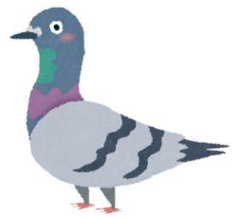

鳩の特性
仮に，鳩しかいない，とします．
鳩がたくさんいます．攻撃はありません．半々に分け合います
半々に分け合う
Notes:
The first behaviour the students will explore is the Hawks. At this point you will need to explain the “rules.” Everyone in the class is going to be a Hawk. They are going to compete over the 4 resource cards they hold in their hands. These resource cards are going to be used as a surrogate measure of FITNESS. The more resources an individual has, the more likely it is to survive and reproduce. To compete for the resource, they are going to turn to their neighbour and “fight” using ROCK-PAPER-SCISSORS. The winner takes ONE RESOURCE card from the loser. The loser, because hawks fight aggressively over the resource, suffers an injury cost. So, the loser must put TWO RESOURCE cards in his/her back pocket (these are lost and can’t be used again).
Ask everyone to have TWO INTERACTIONS (COMPETITIONS) for the resources. This must be exactly 2 interactions, no more, no less.

Slide 15
たくさんの鷹と鳩が混ざり合っているとします
鳩は，生き残ることができるでしょうか？
鷹は，生き残ることができるでしょうか？
鳩の数が，鷹の数を上回ることはありえるでしょうか？
鷹の数が，鳩の数を上回ることはありえるでしょうか？
Notes:
Select a student (ideally someone you know won’t be embarrassed!). Tell the students that this individual has a random mutation that causes them to adopt a DOVE behavioural strategy. You may have to remind them of the rules that when a hawk and dove interact, the hawk always wins and just takes the resource.
Let the Dove try to “invade” the population of hawks. What you should see is that the dove loses a resource card for each interaction and that after 4 interactions the dove is left with no resources. Then ask: Can a dove invade a population of hawks? NO!
You could ask the first question as a clicker question, if you have the time.

Slide 16
鷹の気持ちで
鷹が多くいるとき
鷹に多く出会い，鷹と攻撃しあう．
ケガがおおい（不利）
鳩が多くいるとき
鳩に多く出会い，鳩は逃げる．
総取りなので有利
Notes:
. If a Hawk and Hawk compete over a resource, they do Rock-Paper-Scissors to fight over the resource. The loser gives one resource card to the winner and loses (into the back pocket) 2 resource cards for injury cost, just like before. When a Hawk encounters a Dove, it always wins the competition, and doesn’t sustain an injury cost. When two Doves interact, they do Rock-Paper-Scissors over the resource, and sustain no injury cost. When students approach each other, they need to tell each other what they are (Hawk or Dove) and then proceed.
Now if an individual loses all the resources in their hand, they are ‘dead’ and must sit down.
If an individual has 8 resources cards in their hand, they must reproduce by giving someone who is sitting down 4 resource cards and telling that individual whether they are now a hawk or a dove.
For this to work, you will need a TA to be a ‘decomposer’. This person will approach dead individuals and ask them for any resources they have in their back-pocket. If they retrieve cards, they should give them out randomly to those individuals that are still alive. Without the decomposers resources end up bound in the back pockets of individuals and there is a constant loss of resources from the ‘system’. Redistributing these resources when an individual has died mimics nature.
By allowing individuals to ‘die’ and ‘reproduce’ you can now see that the proportion of individuals in the class that are hawks and doves evolve.

Slide 17
鳩の気持ちで
鷹が多くいるとき
鷹に多く出会う．
逃げる．餌や水は鷹のもの．
鳩が多くいるとき
鳩に多く出会い，
餌や水は半々になる
Notes:
. If a Hawk and Hawk compete over a resource, they do Rock-Paper-Scissors to fight over the resource. The loser gives one resource card to the winner and loses (into the back pocket) 2 resource cards for injury cost, just like before. When a Hawk encounters a Dove, it always wins the competition, and doesn’t sustain an injury cost. When two Doves interact, they do Rock-Paper-Scissors over the resource, and sustain no injury cost. When students approach each other, they need to tell each other what they are (Hawk or Dove) and then proceed.
Now if an individual loses all the resources in their hand, they are ‘dead’ and must sit down.
If an individual has 8 resources cards in their hand, they must reproduce by giving someone who is sitting down 4 resource cards and telling that individual whether they are now a hawk or a dove.
For this to work, you will need a TA to be a ‘decomposer’. This person will approach dead individuals and ask them for any resources they have in their back-pocket. If they retrieve cards, they should give them out randomly to those individuals that are still alive. Without the decomposers resources end up bound in the back pockets of individuals and there is a constant loss of resources from the ‘system’. Redistributing these resources when an individual has died mimics nature.
By allowing individuals to ‘die’ and ‘reproduce’ you can now see that the proportion of individuals in the class that are hawks and doves evolve.

Slide 18
鳩と鷹の利得表
 | 鷹 | 鳩
鷹 | 勝つ：餌，水をすべて 負ける：けがをする 0.5 R - 0.5 C | 餌，水をすべて R
鳩 | 逃げる 0 | 餌，水を半分 0.5 R
R: 餌，水
C: けが
http://sciencecases.lib.buffalo.edu/cs/collection/detail.asp?case_id=763&id=763 より

Slide 19
鳩と鷹の利得表
Relative frequency of Hawks = p
Relative frequency of Doves = 1-p
Average payoff for Hawk = p∙(0.5∙R - 0.5∙C) + (1 - p)(R)
Average payoff for Dove = p ∙ 0 + (1-p) ∙ (0.5∙R)
http://sciencecases.lib.buffalo.edu/cs/collection/detail.asp?case_id=763&id=763 より

Slide 20
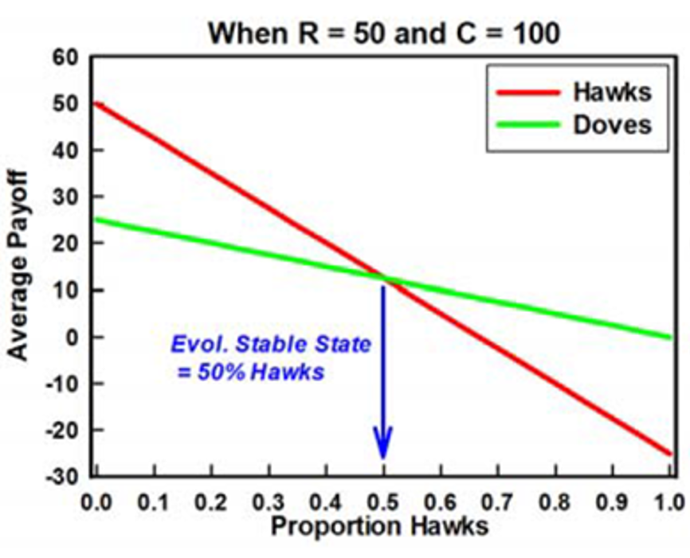
鷹と鳩の割合によって，有利不利が変わる
鷹が増えると －＞ 鷹が不利に
鳩が増えると －＞ 鳩が不利に
ある一定割合のバランスで落ち着く
http://sciencecases.lib.buffalo.edu/cs/collection/detail.asp?case_id=763&id=763 より

Slide 21
13-2. グラフの最短経路などの
アルゴリズムをビジュアルに表示する
オンラインサイト www.algoanim.ide.sk の紹介

Slide 22
グラフ
多数のオブジェクトの２項関係を考えるもの
２項関係の例
(A, B) (A, C) (B, D)
知り合いである．連結している．隣接している．
などの関係を示す．

Slide 23
グラフの応用例
交通ネットワーク解析（最短経路探索など）
Webページのリンク
電子回路での接続関係
タンパク質の相互作用
人間の言葉（単語間の類似性など）

Slide 24
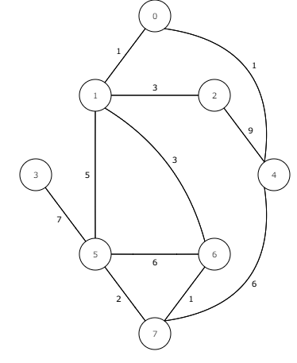
グラフ
0
〇 ノード
線 エッジ
1
2
3
4
用途
・道路のつながり具合
・バス路線
など
5
6
7

Slide 25
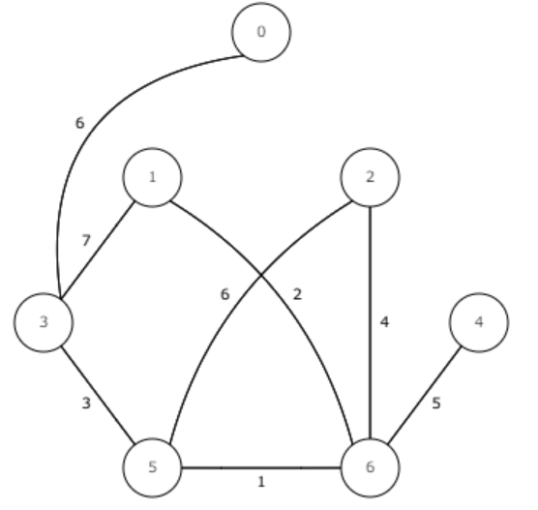
経路探索
1 から 0 への最短経路は：
1 6 5 3 1
の中の数値は距離

Slide 26
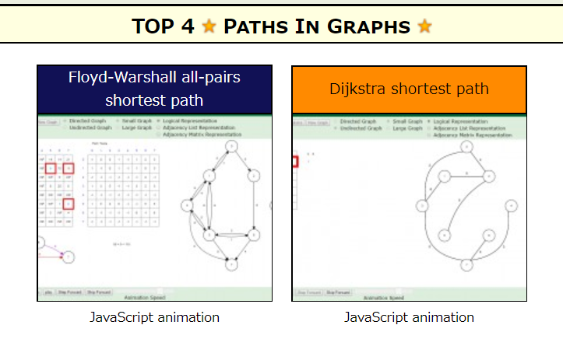
演習
① ウェブブラウザを起動する
② 次の URL を開く
http://www.algoanim.ide.sk/
③ PATHS IN GRAPH の「Dijkstra shortest path」をクリック

Slide 27
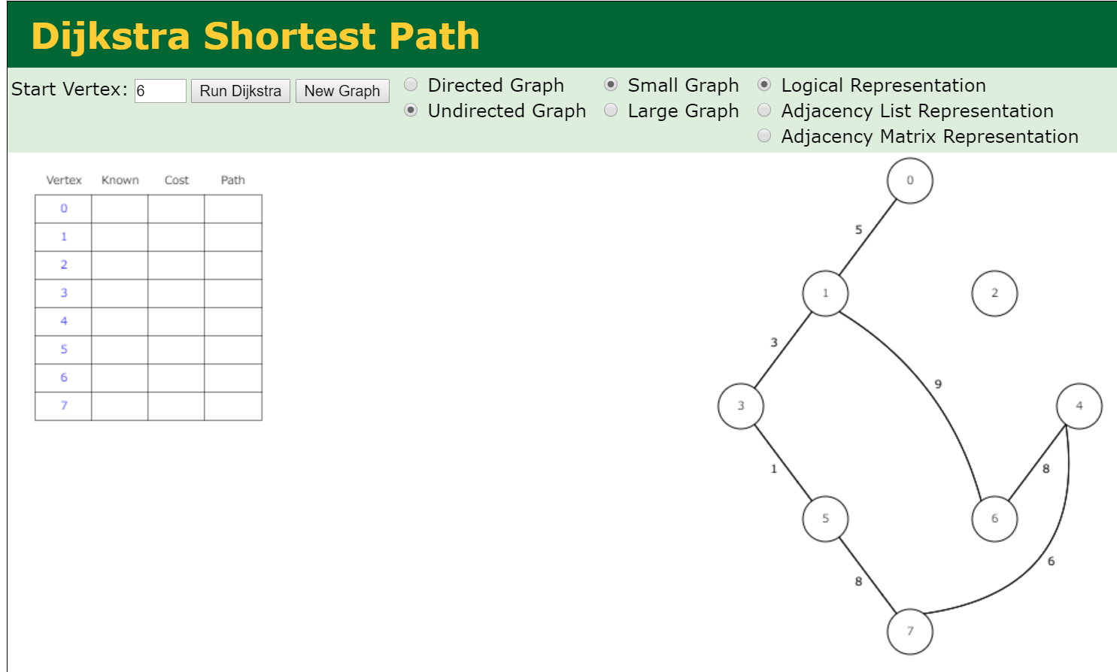
④ Start Vertex のところに節番号 （数値）を半角で入れ、「Run Dijkstra」をクリック

Slide 28
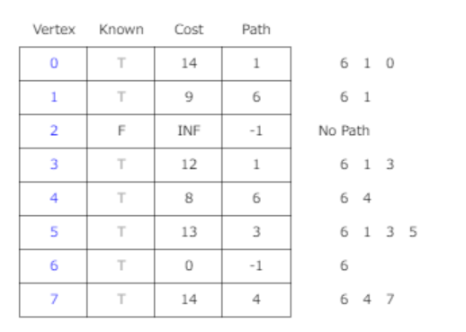
⑤ 結果として、他の節への最短経路が表示されるので、確認する。Start Vertex のところを他の数値にしていろいろ試してみる

